Slide 1
Prototyping challenge
Smart thermostat

Slide 2
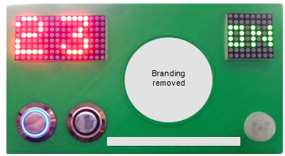
Today's challenge: Build a "smart" thermostat prototype
Key features
"Dumb" thermostat
Read room's temperature
Sets desired temperature
Wi-Fi Controllable
Mobile controllable (read, set)
"Smart" features
Detect in-room motion

Slide 3

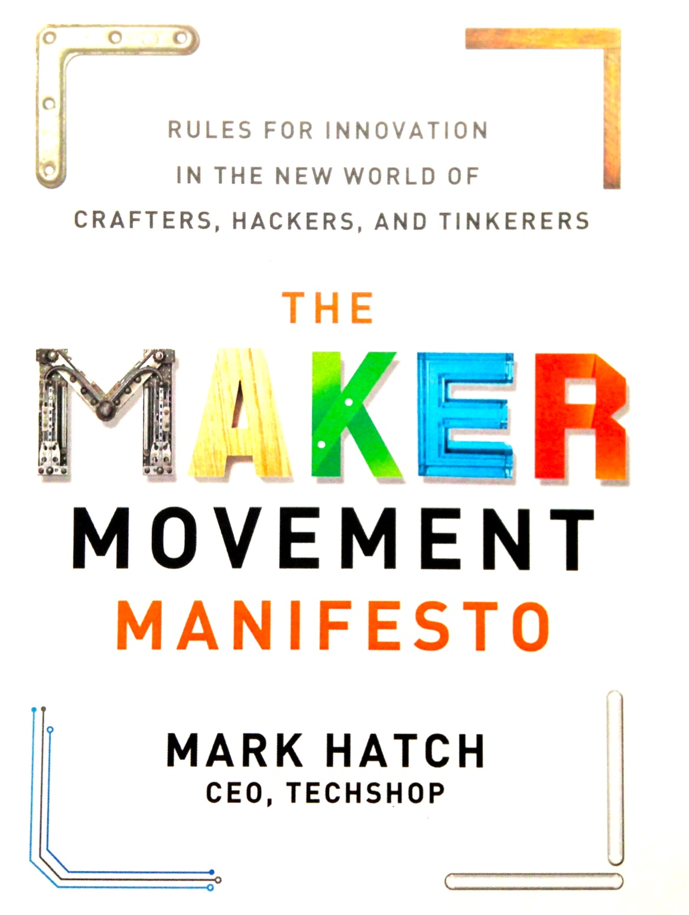
Challenge highlights growing publicity of "Maker Movement" and its potential to disrupt
Community of technology-centric DIYers emphasizing learning through doing, peer-to-peer instruction, and self-fulfillment

Slide 4
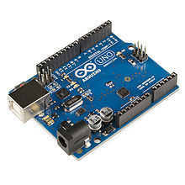
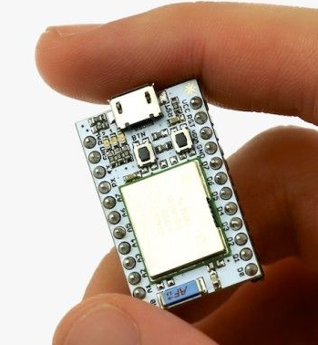
Low-cost open-source hardware have enabled large communities of "makers"
Arduino
Spark Core
Single board microcontroller, introduced in 2005
Open source hardware
~700K units produced to date
Cost ~$30 / board
Updated chip + built-in Wi-Fi w/ cloud development suite
Kickstarter funded 2013
Open source hardware
Cost ~$40 / board

Slide 5
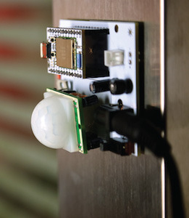
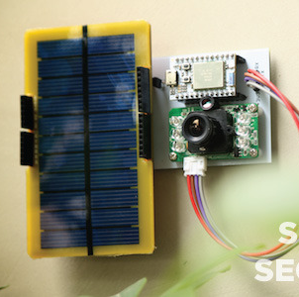
OS-Hardware connects w/ available components
Spark Wireless motion detector
Spark solar powered security camera

Slide 6
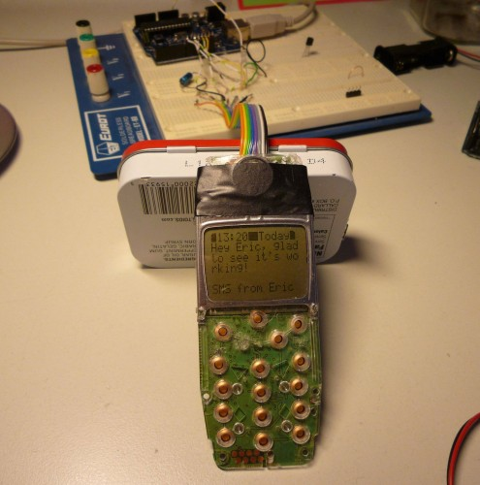
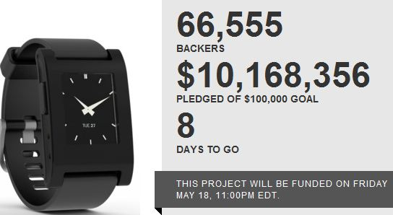
OS-Hardware allows for MVP market validation Pebble prototyped smartwatch w/ Arduino, prior to $10M Kickstarter funding

Slide 7
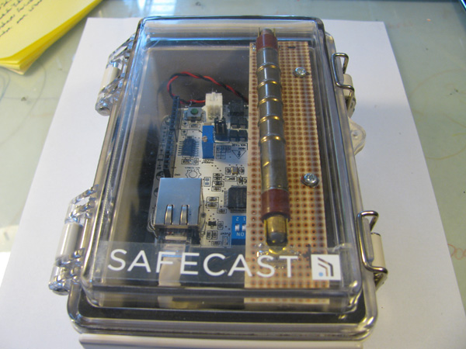
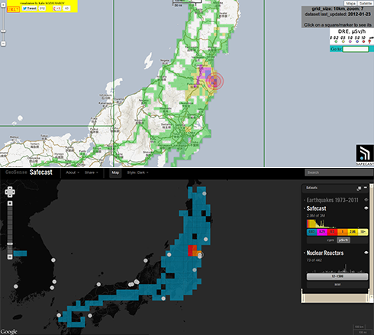
OS-Hardware allows for rapid product deployment Networked Geiger-counters rapidly developed & deployed following Fukushima disaster
Real-time sensor network (post-Fukushima disaster)
Arduino-based Geiger counter

Slide 8
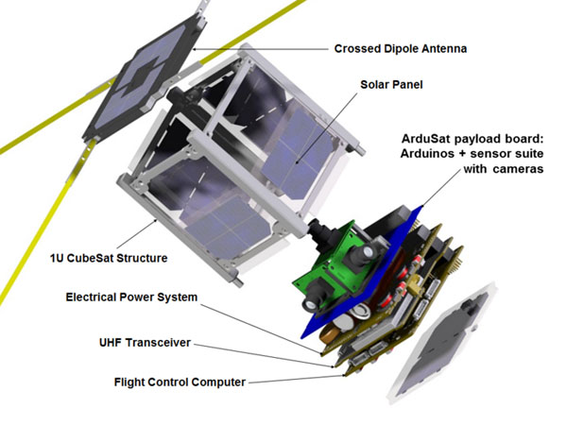
OS-Hardware lowers barriers on high-end R&D
ARDUSAT Arduino-based satellite for community use

Slide 9
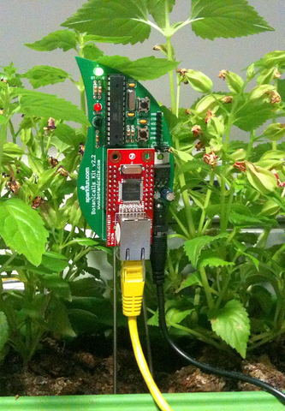
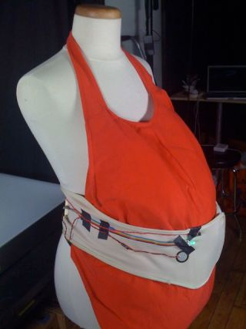
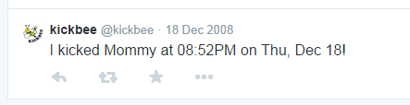
OS-Hardware supports high levels of innovation
"Botanicalls" Plants tweet when thirsty
"Kickbee" A tweet for every kick

Slide 10
Today's challenge: Assemble prototype
Teams of 10, sub-divides into Hardware, Software teams
Hardware, Software teams responsible for creating functioning prototype
Team seating arrangement
2 Hours to complete assembly
Team of helpers available to assist you
Dashboard projected in room will track progress and rank teams throughout
1
...
6
7
...
12
13
...
19
20
...
24

